Slide 1
Welcome to Arabic Level I by Kurzban

Slide 2

Lesson 15:
Objectives:
Review
Arabic Alphabet: Two-Way Connectors: Lam
Arab States: Identifying and inquiring about Arab countries, capitals, and cities
Practice
Summary
Flash card
http://www.youtube.com/watch?v=VHKKxO3JmGA

Slide 3
Do Now: Review
Listen to each word dictated to you and write it down on a ruled sheet of paper. Each word will be read twice.

Slide 4
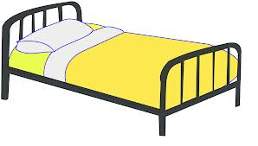
Lesson 15: Building up voca
Copy down and translate the following words on your paper several times and remember to proceed from right to left.
Make It
This is a bed: ______________
This is my bed: ____________
This is his bed: ___________
This is her bed : ___________
سَرير

Slide 5

Lesson 15:
Copy down and translate the following words on your paper several times and remember to proceed from right to left.
This is my : _____
This is his : ____
This is her : ______
I have a ……..
Yes I do have :…..
دَرّاجة

Slide 6
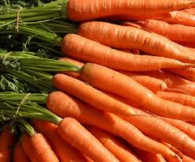
Lesson 15:
Copy down and translate the following words on your paper several times and remember to proceed from right to left.
Follow the trend:
Mine ______
Hers:_______
His:_______
جَزَر

Slide 7

Lesson 15: Building up your vocabulary
Copy down and translate the following words on your paper several times and remember to proceed from right to left.
Mine: ____
His: _____
Hers:______
ثَور

Slide 8
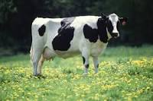
Lesson 15
Copy down and translate the following words on your paper several times and remember to proceed from right to left.
Mine: ____
His: ____
Hers:_____
بقرة

Slide 9

Lesson 15
Copy down and translate the following words on your paper several times and remember to proceed from right to left.
Mine: ___
Hers: ____
His: _____
دجاجة

Slide 10
The letter Lam: two way connector
It is important to remember that lam can be joined on both sides, as beginners often confuse this letter with alif, which can be joined only to the letter before:
ك+ل+ب=

Slide 11
The letter lam
This letter has a distinct shape in final and independent position.
Independent; it will look like: _____________
Final connected: ______________
Medial, two way connector: ______________
Initial, do not confuse it with Alif: ______________

Slide 12
Let’s practice with “lam”
ق+ل+م
س+ل+ي+م=
ق+ل+م م+ك+س+و+ر=

Slide 13
When an alif follows lam
Alif is embeded inside lam

Slide 14
Lesson 15
Copy down and translate the following words on your paper several times and remember to proceed from right to left.
Where? أيْنَ؟
When? مَتَى؟
Why? لِماذا؟
In what? In Which? (m./f.) فِي أيِّ؟ أيَّةِ؟

Slide 15
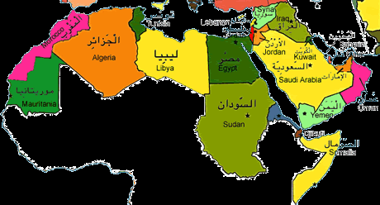
Lesson 12: Inquiring about and identifying Arabic Cities
The map below displays some of the names and locations of some Arab cities.

Slide 16
Lesson 15: Inquiring about and identifying Arabic Cities
For practice, ask your partner where certain town is located and answer the question using the name of that city and the country.
Here is an example:
أينَ بَغْداد؟
بَغْداد في العراق

Slide 17
Lesson 15: Inquiring about and identifying Arabic Cities
You might need to learn about capital cities of some Arab countries in order to finish this exercise.
Capital Country
المغرب الرباط
مصر القاهرة
لبنان بيروت

Slide 18
Dictation
Listen to each word dictated to you and write it down on a ruled sheet of paper. Each word will be read twice.
زوج
زوجة
أبن
بنت

Slide 19

Review
Review
Make your flash card for this lesson
Questions????

Slide 20
Connect the following letters to form words and write the transliteration for each.
بَ+ق+ر+ة=
سِ+ب+ا+ق=
بِ+خَ+يْ+ر=
تَ+مَ+ا+م=
تَ+عْ+ب+ا+ن=
تَ+شَ+رَّ+فْ+ن+ا=
خُ+ط+و+ط=
شَ+ا+رِ+ع=
قَ+مَ+ر=

Slide 23
لَ+يْ+مُ+ن=
إ+غْ+ل+ا+ق=
عَ+س+ل=
جَ+ل+ا+ل=

